Slide 1
Section 5: International Trade 15. Gains from Trade 16. Supply, Demand, and International Trade
15-16

Slide 2
Gains from Trade
15

Slide 3
WHAT YOU WILL LEARN
What is comparative advantage and why does it lead to international trade?
What are the sources of comparative advantage?

Slide 4

THE EVERYWHERE PHONE
iPhones involve displays from South Korea, assembly in China, research from the United States, and raw materials from all over the world.
Trade makes the world economy more productive and, as a result, richer.
Notes:
Image: Imaginechina/Corbis

Slide 5
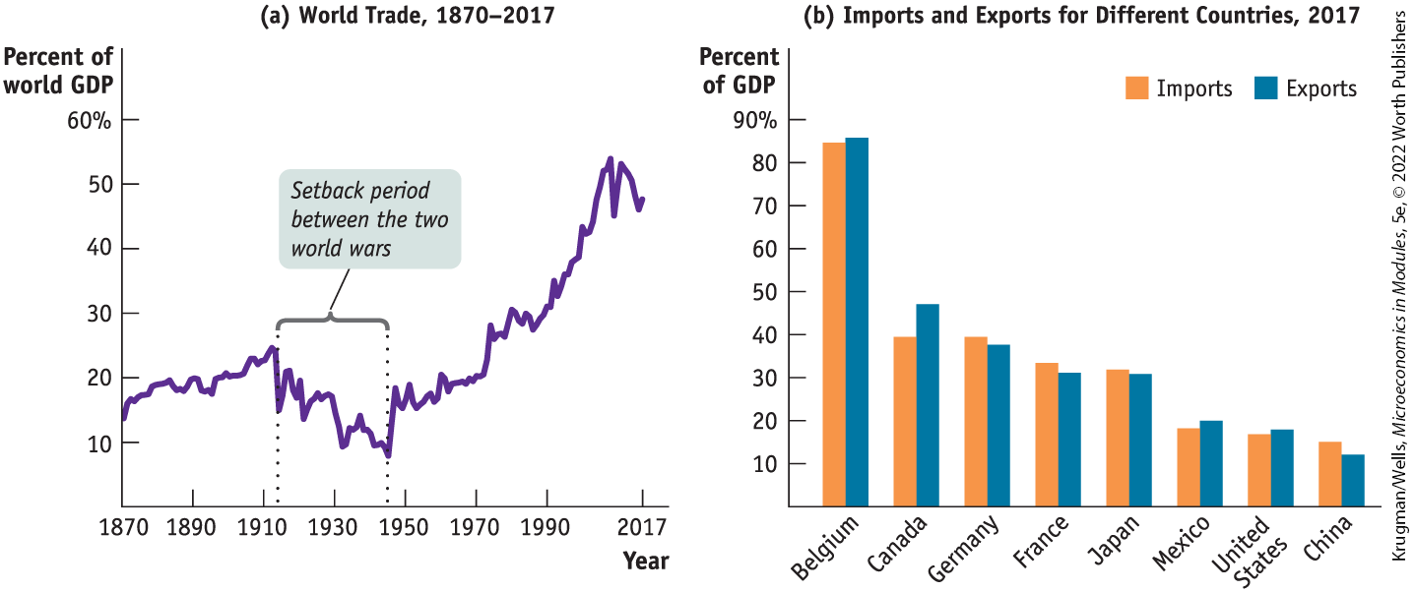
THE GROWING IMPORTANCE OF INTERNATIONAL TRADE
International trade is more important for the United States than it used to be and is more important for some countries than others.
Figure 15-1
Hyperglobalization is the phenomenon of extremely high levels of international trade.

Slide 6
COMPARATIVE ADVANTAGE AND INTERNATIONAL TRADE
Recall from Module 3: A country has a comparative advantage in producing a good or service if the opportunity cost of producing the good or service is lower for that country than for other countries.
The Ricardian model of international trade analyzes trade under the assumption which makes production possibilities frontiers straight lines (they are straight because we assume constant opportunity costs).

Slide 7
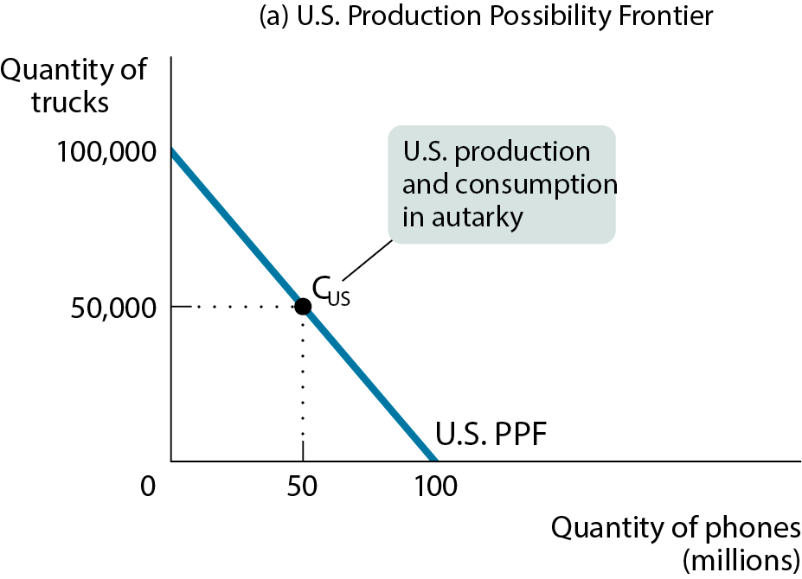
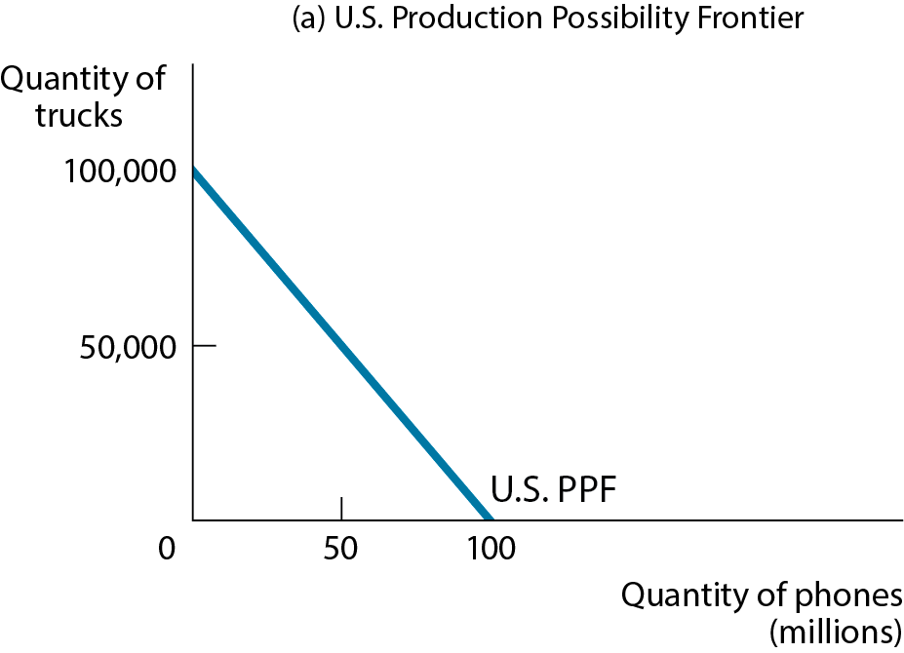
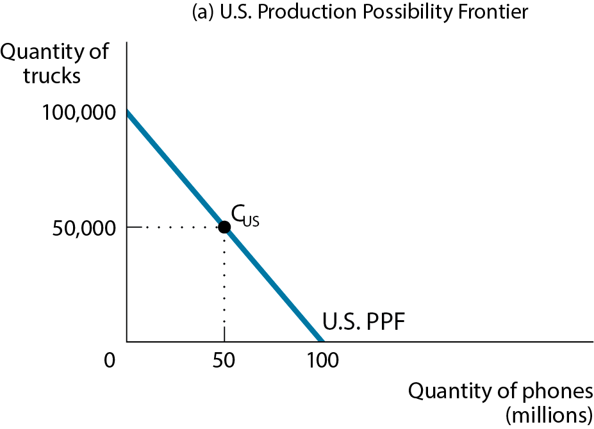
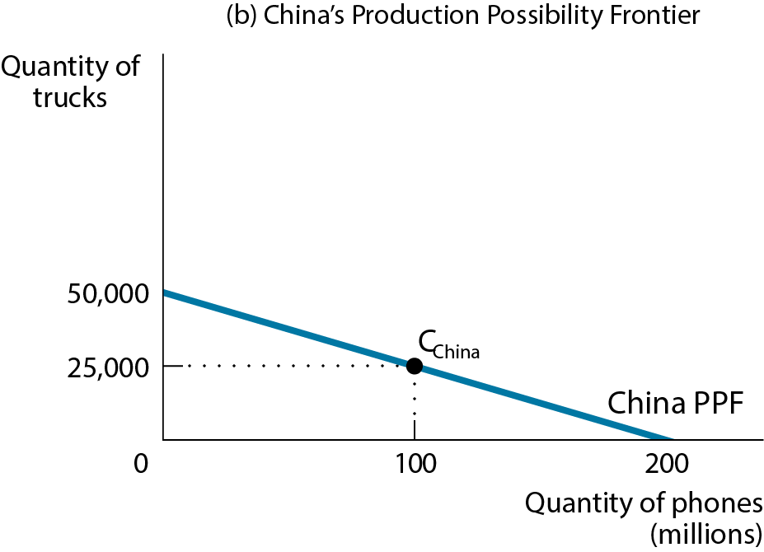
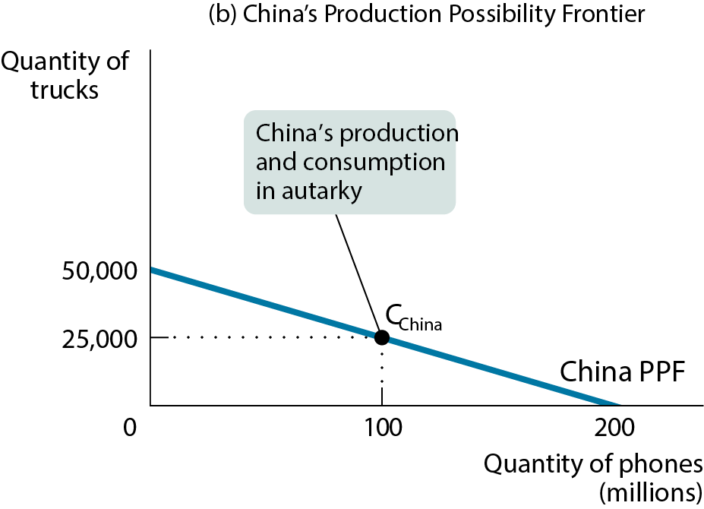
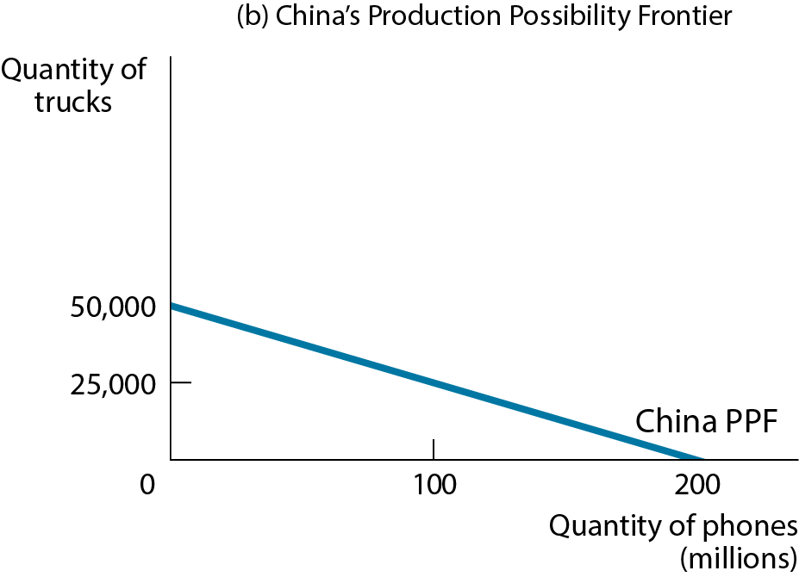
COMPARATIVE ADVANTAGE AND INTERNATIONAL TRADE
Autarky: a situation in which a country does not trade with other countries
Figure 15-2

Slide 8
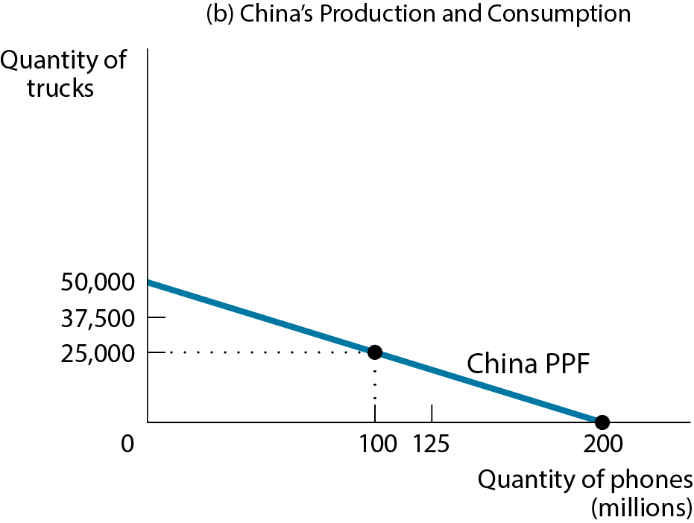
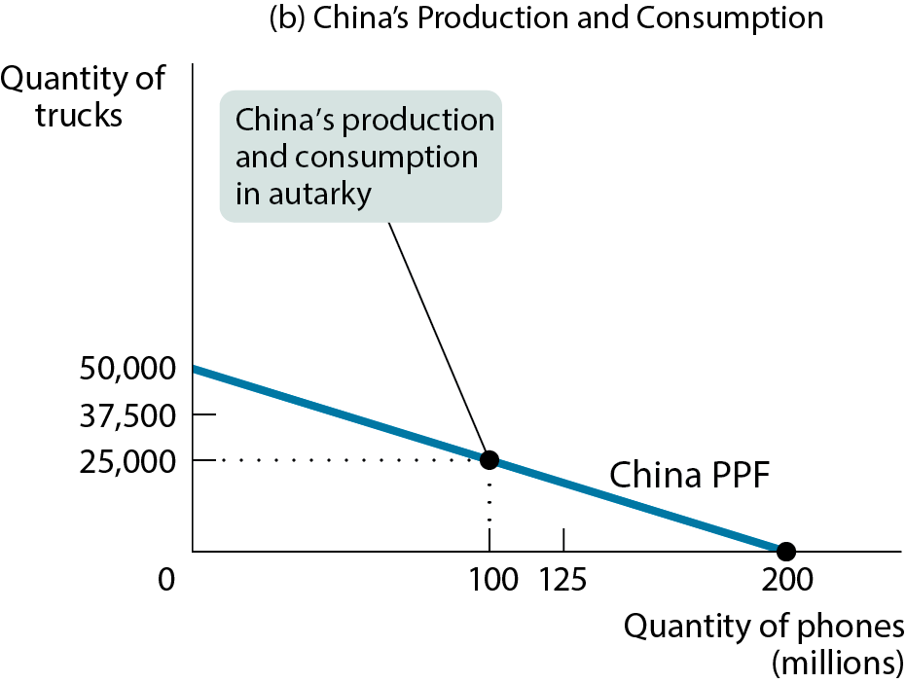
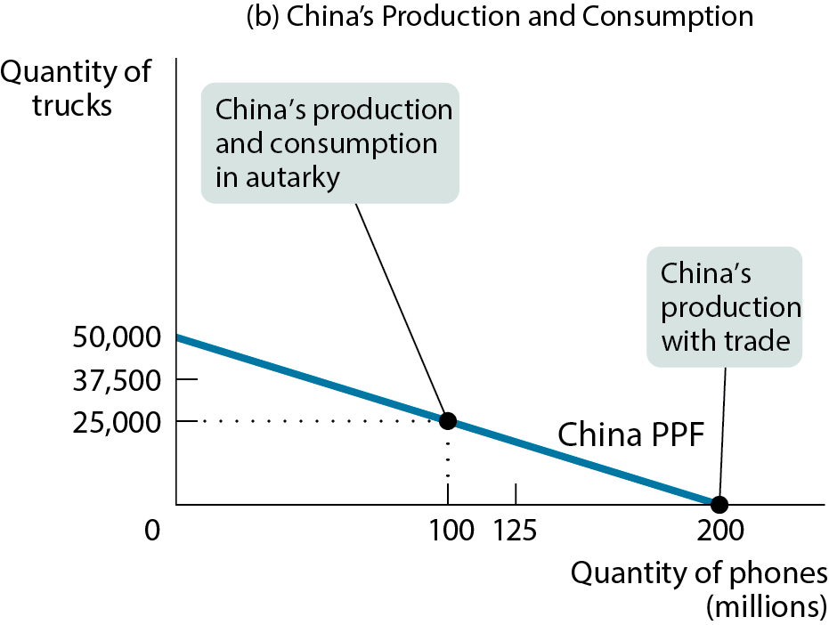
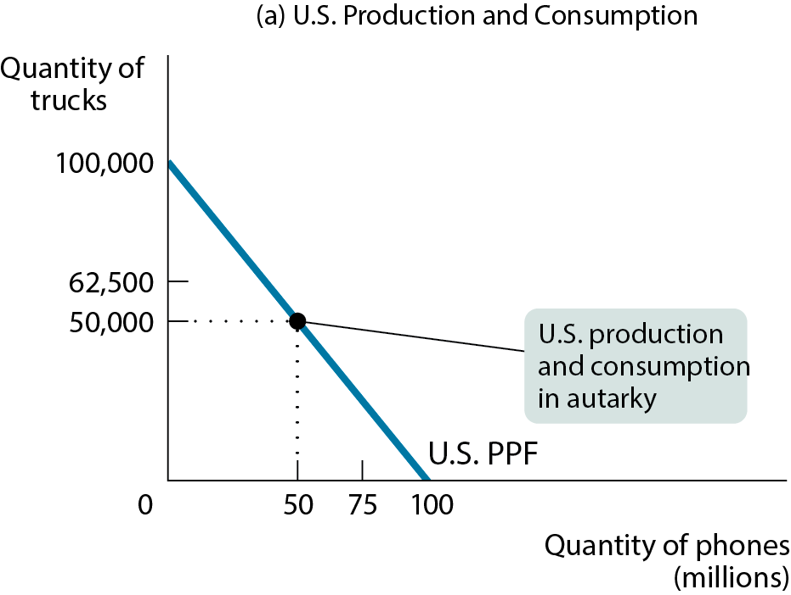
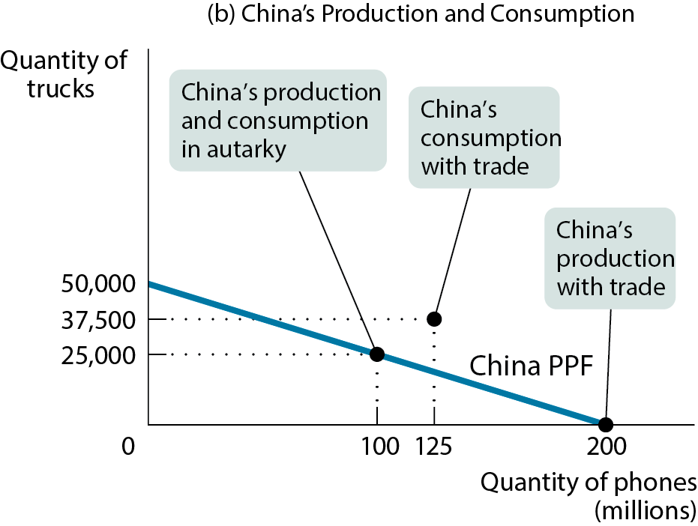
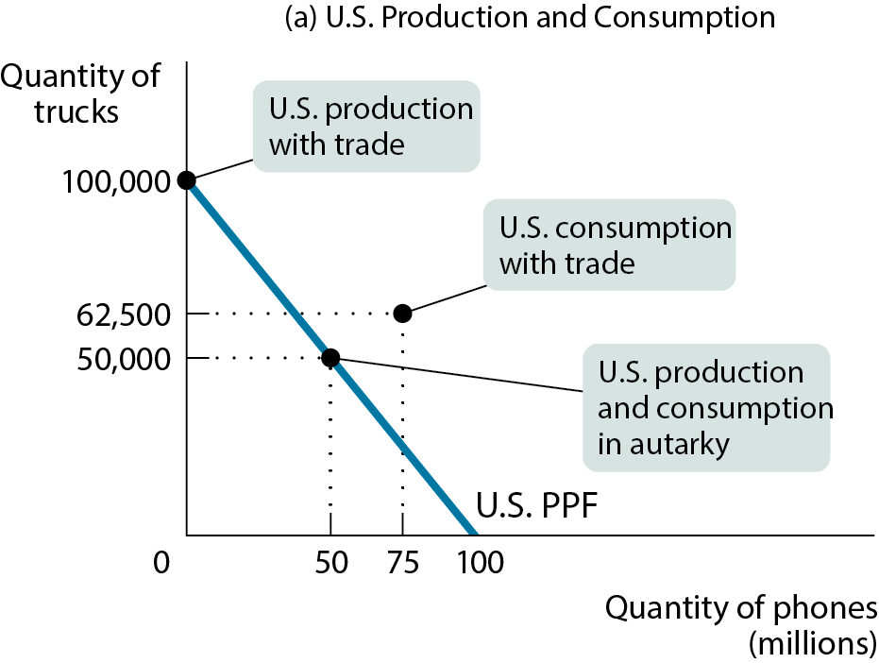
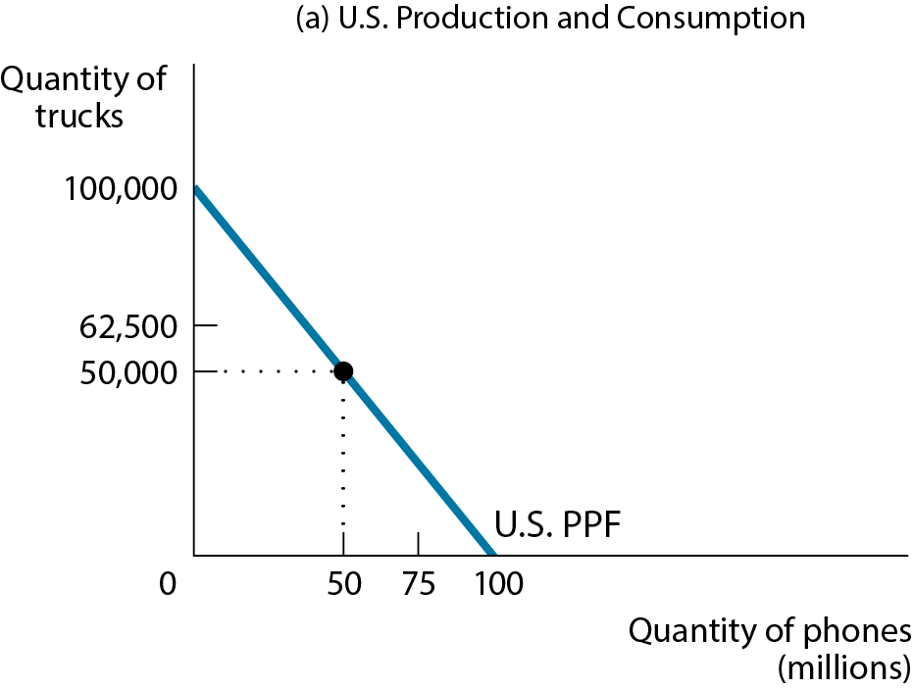
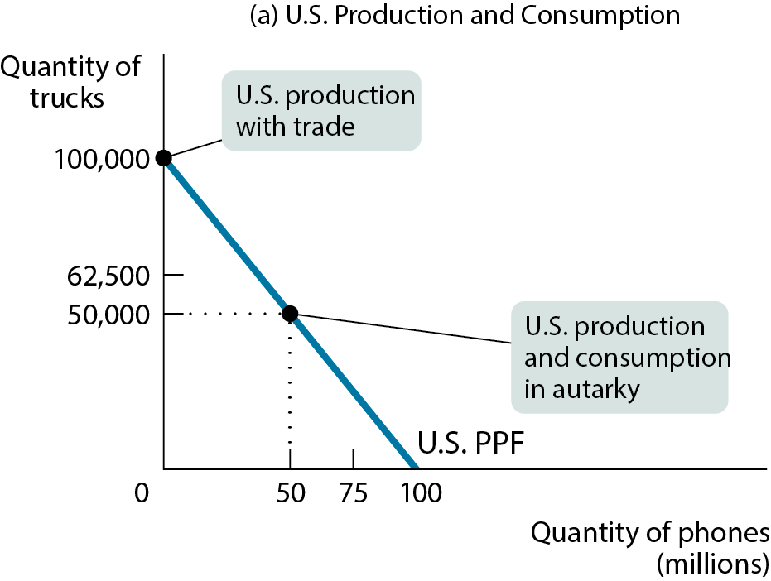
THE GAINS FROM INTERNATIONAL TRADE
Since each country has a different opportunity cost, it makes sense to specialize and trade.
If the United States concentrates on producing trucks and China concentrates on producing phones, total world production rises. It is possible for both countries to consume more of both goods.
Figure 15-3

Slide 9
COMPARATIVE ADVANTAGE VERSUS ABSOLUTE ADVANTAGE
Don’t confuse absolute advantage and comparative advantage.
Just because the United States can produce more of both goods doesn’t mean we’re better off without trade.
Pay attention to opportunity costs.
If it’s cheaper for China to produce phones than it is for the United States, the United States will want to import phones from China.

Slide 10
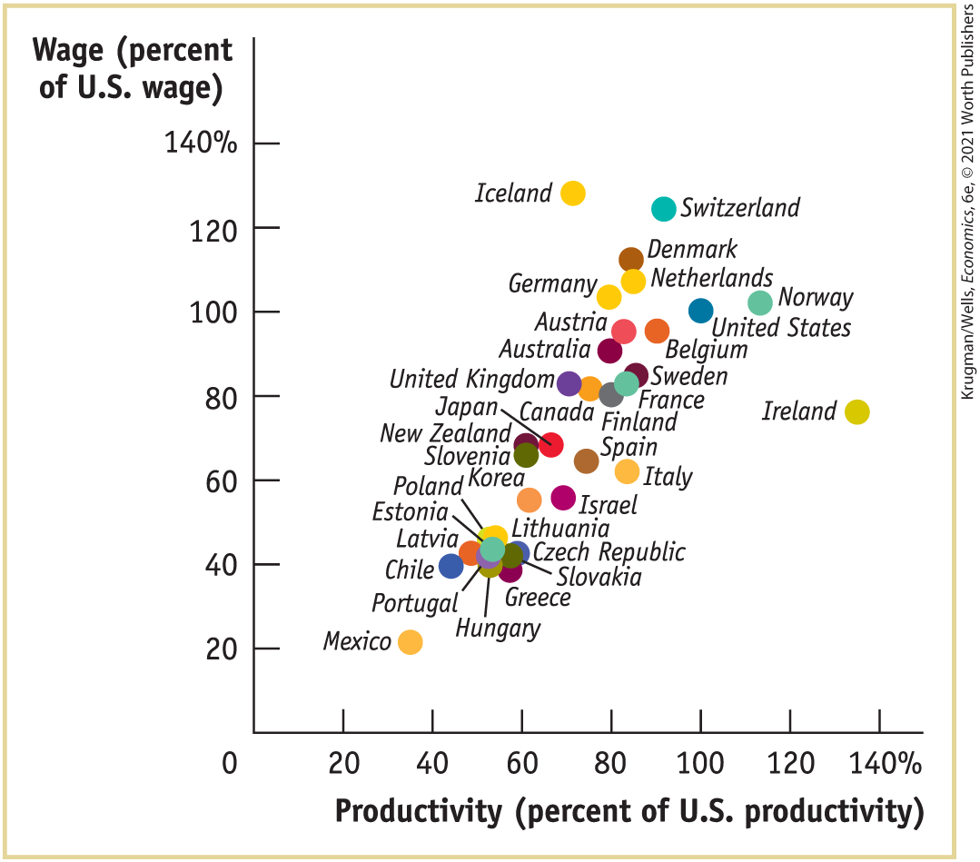
PRODUCTIVITY AND WAGES AROUND THE WORLD
The real explanation for low wages in poor countries is low overall productivity.

Slide 11
SOURCES OF COMPARATIVE ADVANTAGE (1 of 3)
Differences in climate
Bananas grow better in certain climates.

Slide 12
SOURCES OF COMPARATIVE ADVANTAGE (2 of 3)
Differences in factor endowments
Canada can produce paper more cheaply because it’s heavily forested.
Factor abundance: the supply of a factor of production relative to other factors
How many forests does a country have compared with machines or people?
Factor intensity: a measure of the quantity of a factor used in comparison with other factors
How much labor is used compared with natural resources or machines?

Slide 13

THE HECKSCHER-OHLIN MODEL
A country that has an abundant supply of a factor of production will have a comparative advantage in goods whose production is intensive in that factor.
A greater endowment of forested land gives Canada a comparative advantage in forest products.

Slide 14
SOURCES OF COMPARATIVE ADVANTAGE (3 of 3)
Differences in technology
Sometimes a country has developed a particular technology that explains its comparative advantage.
Swiss watches, for example

Slide 15
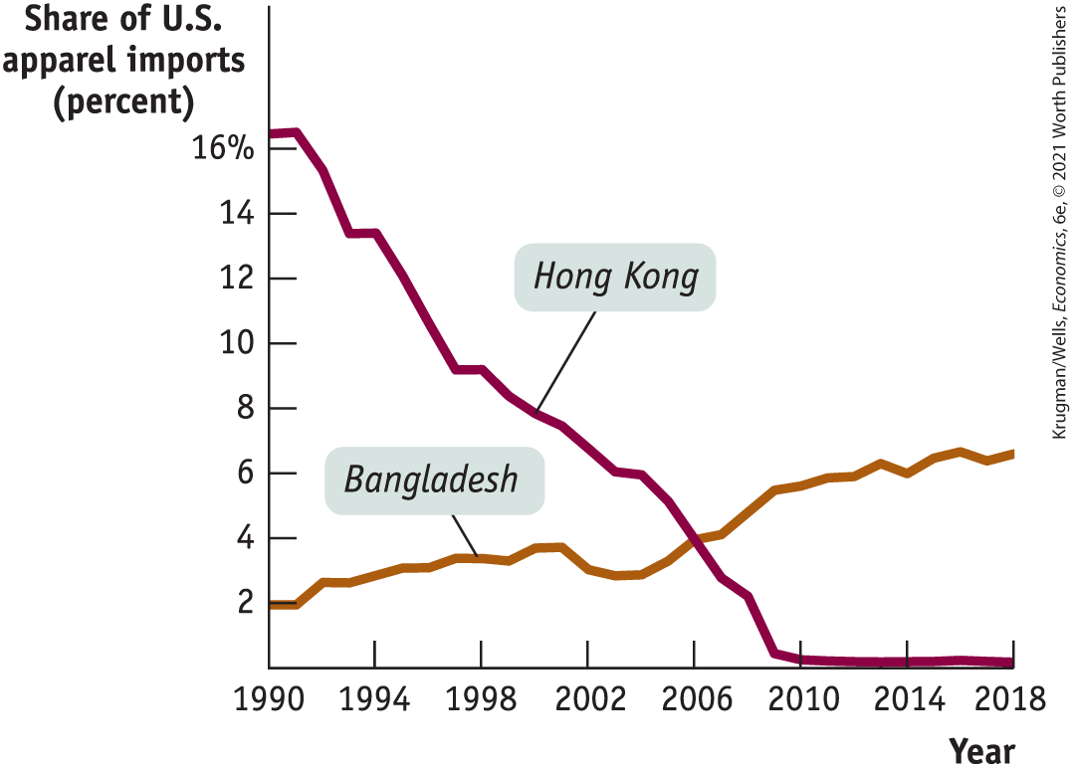
HOW HONG KONG LOST ITS SHIRTS
Hong Kong lost its comparative advantage in garments. Why?
It got better at other things, too, which meant it was now giving up MORE to produce garments.
Notes:
Image: Jennifer Thermes/Getty Images

Slide 16
LEARN BY DOING: PRACTICE QUESTION 1
The United States tends to have a comparative advantage in goods which require
tropical vegetation.
low-skilled labor.
high-skilled labor.

Slide 17
LEARN BY DOING: PRACTICE QUESTION 1 - ANSWER
The United States tends to have a comparative advantage in goods which require
tropical vegetation.
low-skilled labor.
high-skilled labor. (correct answer)

Slide 18
Supply, Demand, and International Trade
16

Slide 19
WHAT YOU WILL LEARN
Who gains and who loses from international trade?
How do tariffs and quotas affect economic surplus?
What are the arguments for and against trade protection policies?

Slide 20
SUPPLY, DEMAND, AND INTERNATIONAL TRADE
Let’s return to the supply and demand model.
We’ll look at
the effects of imports and
the effects of exports on domestic producers and consumers.

Slide 21
THE EFFECTS OF IMPORTS
The domestic demand curve shows how the quantity of a good demanded by domestic consumers depends on the price of that good.
The domestic supply curve shows how the quantity of a good supplied by domestic producers depends on the price of that good.
The world price of a good is the price at which that good can be bought or sold abroad.

Slide 22
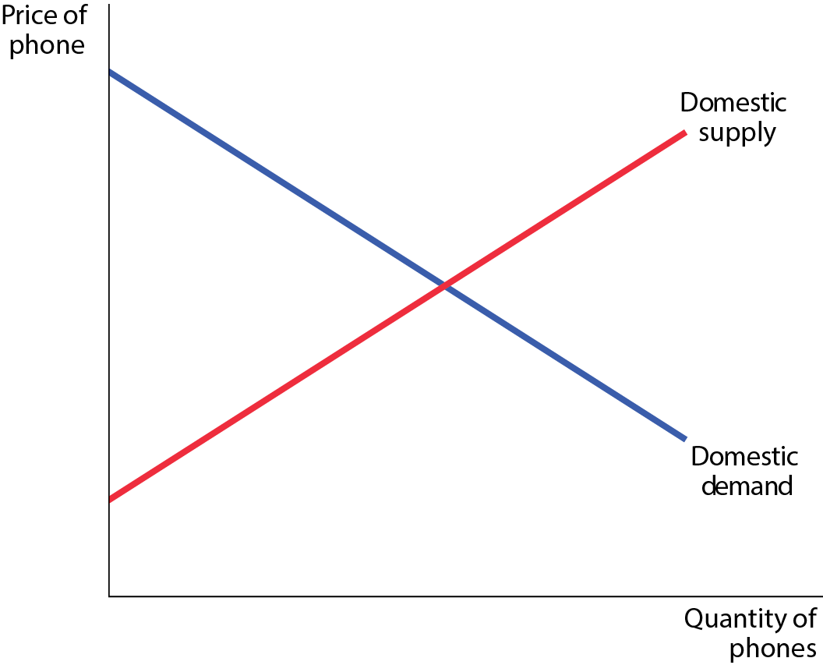
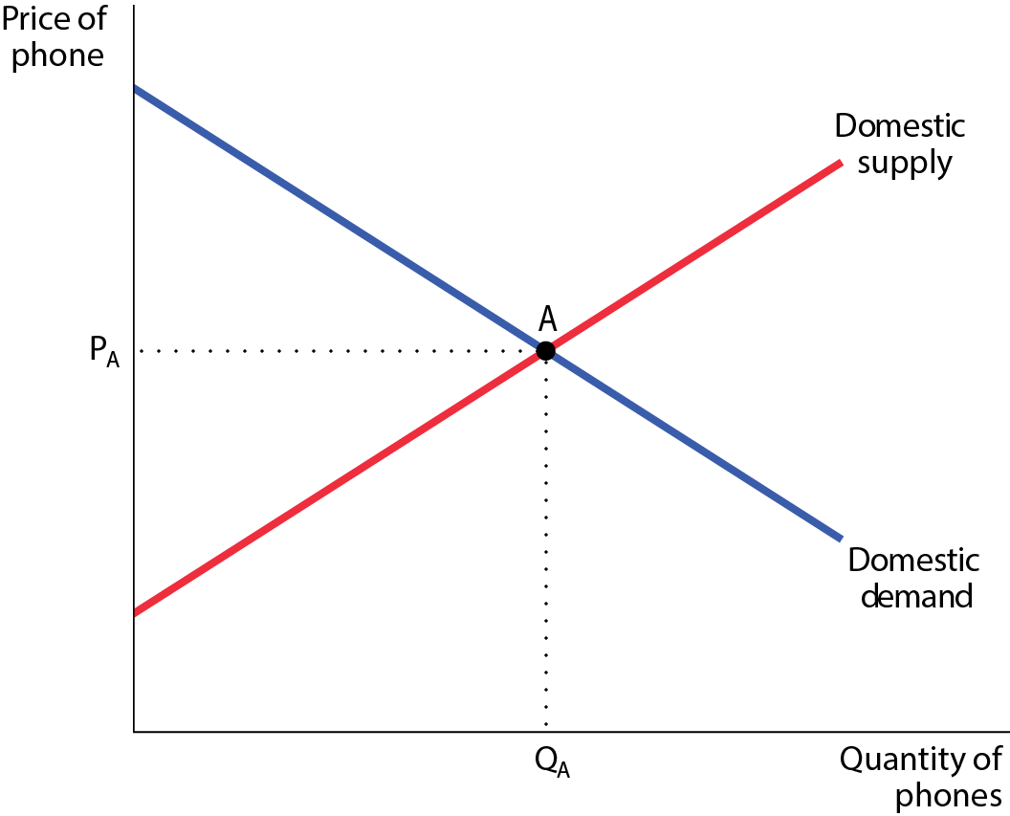
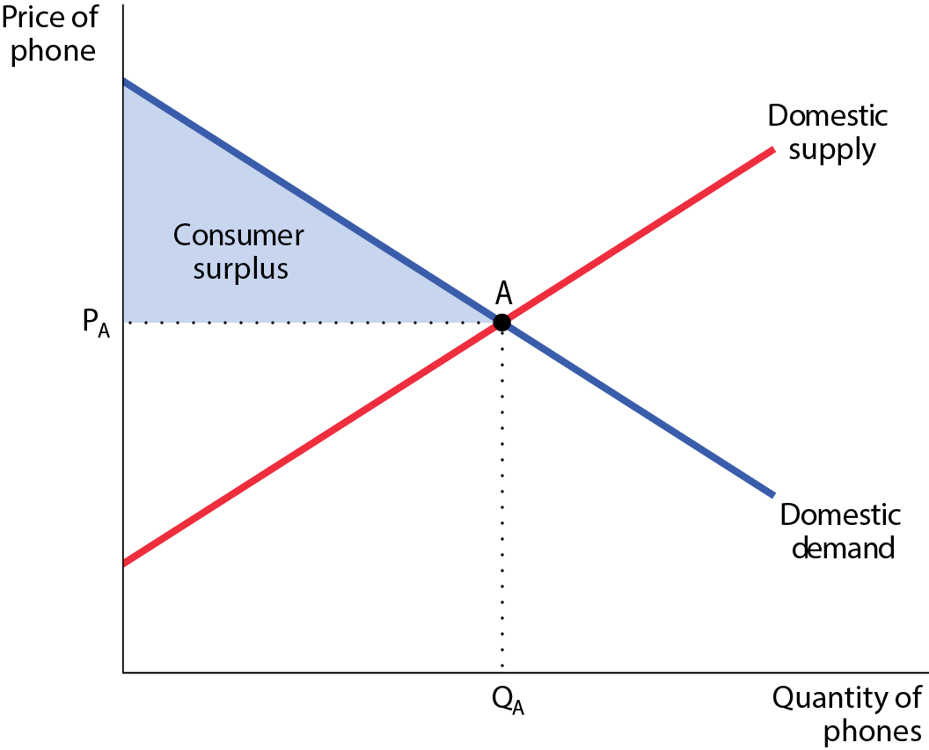
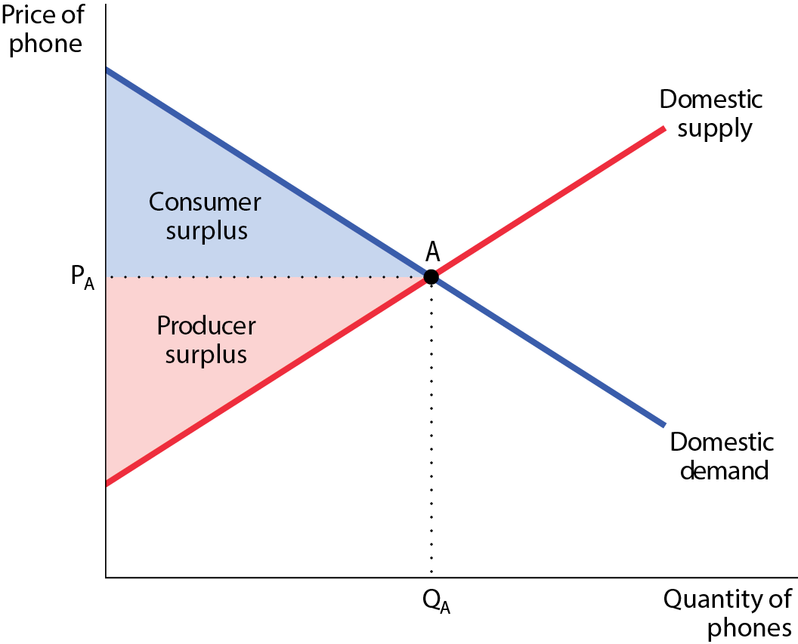
CONSUMER AND PRODUCER SURPLUS IN AUTARKY
Figure 16-1
Without trade, a country’s equilibrium price and quantity depend only on its domestic supply and demand.

Slide 23
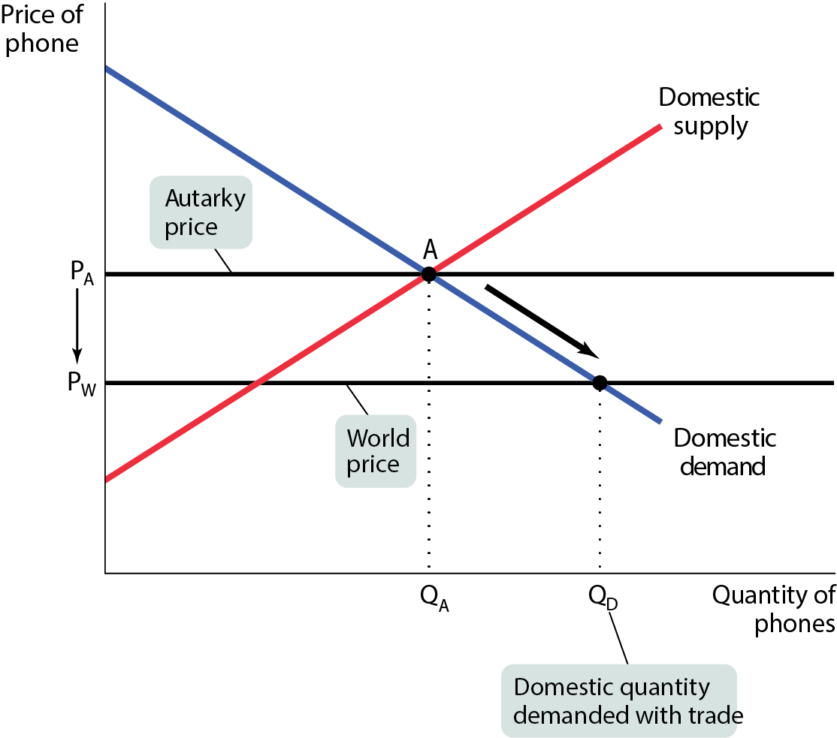
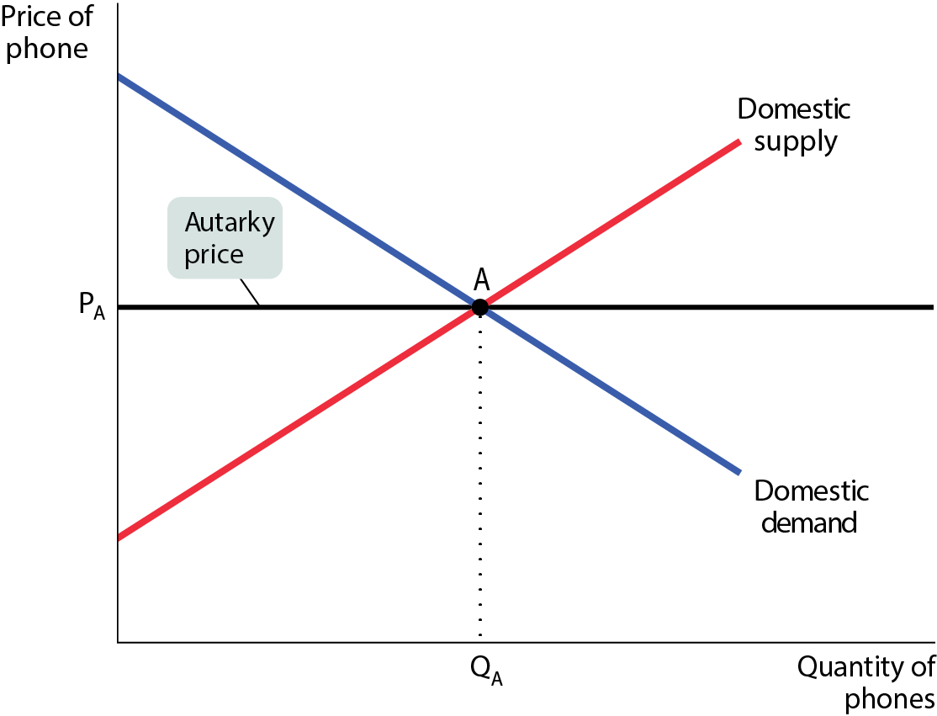
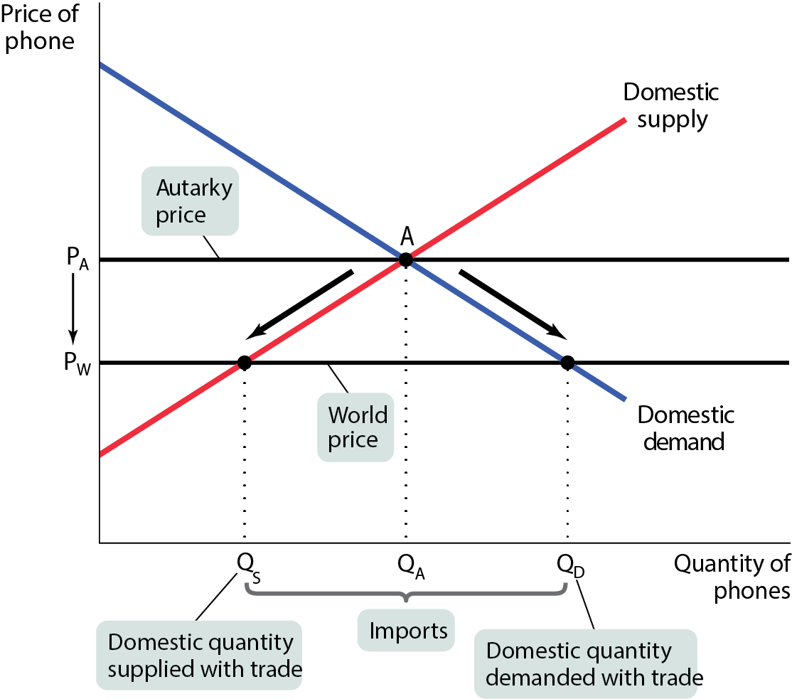
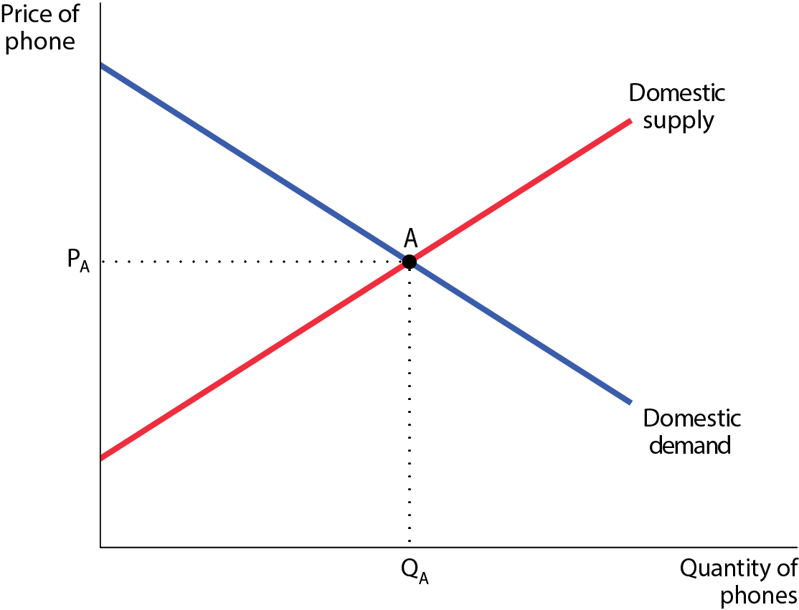
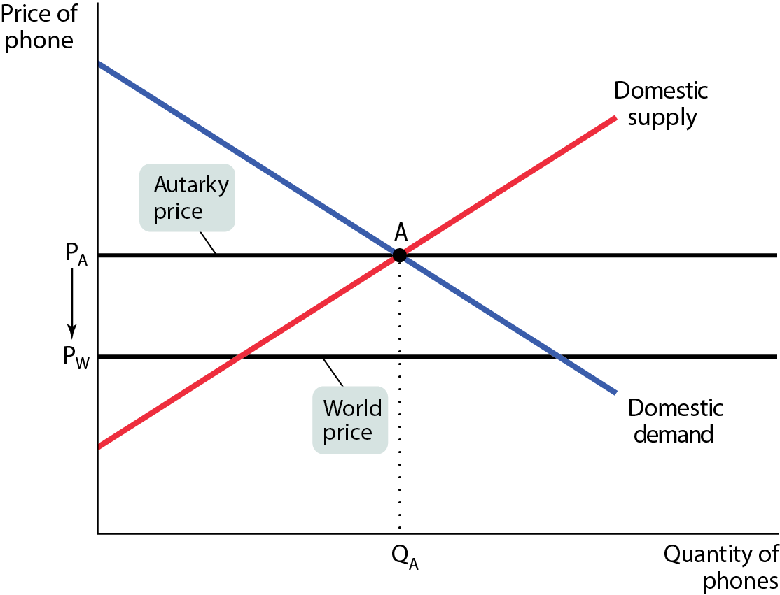
THE DOMESTIC MARKET WITH IMPORTS (1 of 2)
Figure 16-2

Slide 24
THE DOMESTIC MARKET WITH IMPORTS (2 of 2)
When the economy is opened to international trade, imports enter the domestic market, and the domestic price falls from the autarky price, P_{A}, to the world price, P_{W}. As the price falls, the domestic quantity demanded rises from Q_{A} to Q_{D} and the domestic quantity supplied falls from Q_{A} to Q_{S.}
The difference between domestic quantity demanded and domestic quantity supplied at P_{W}, the quantity Q_{D} − Q_{S}, is filled by imports.

Slide 25
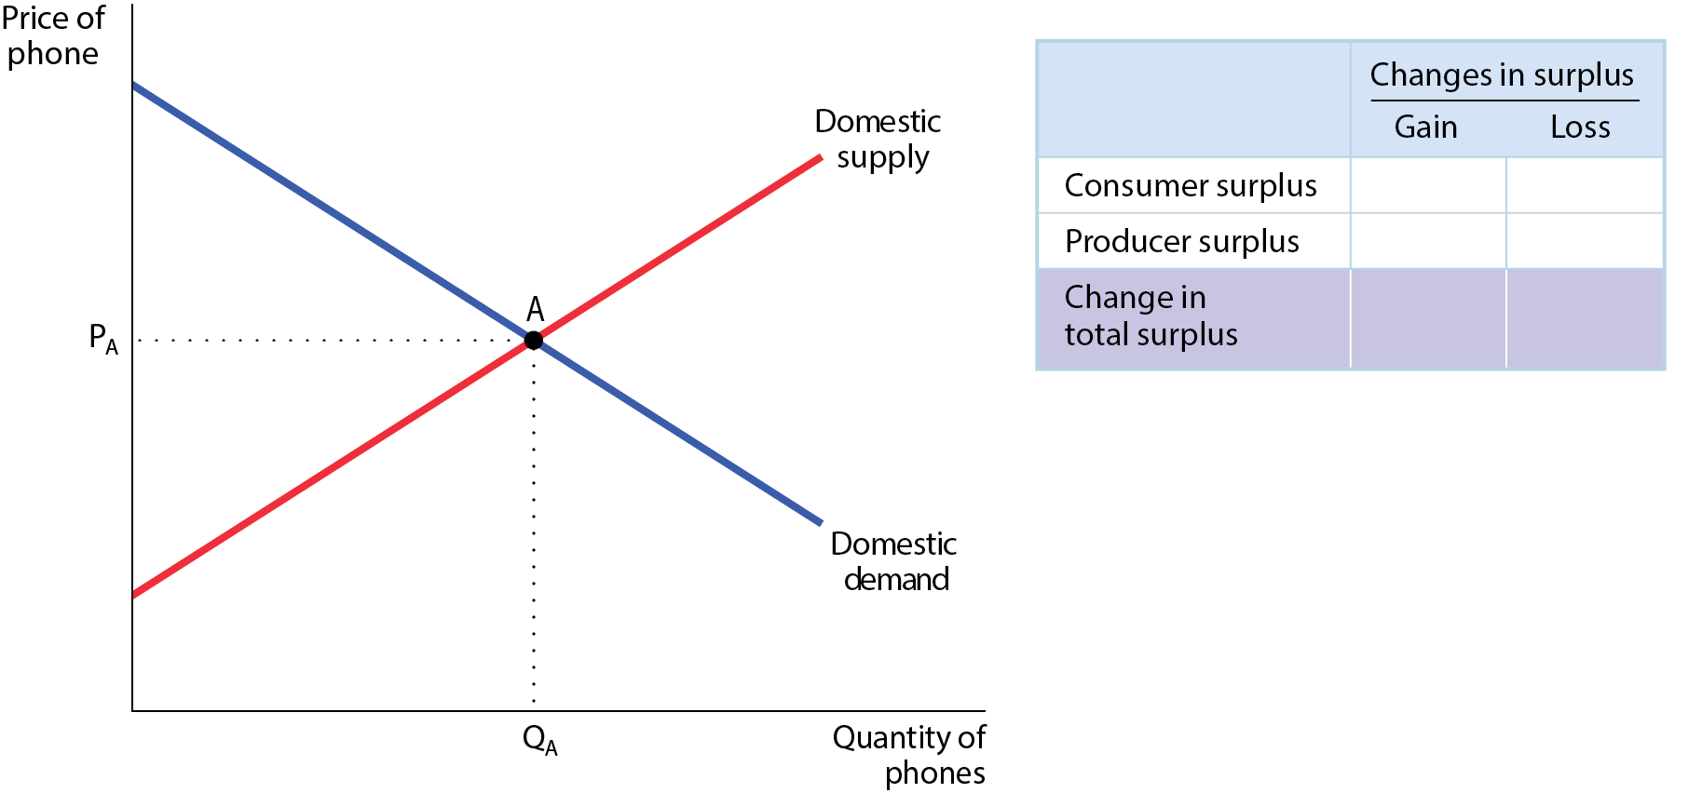
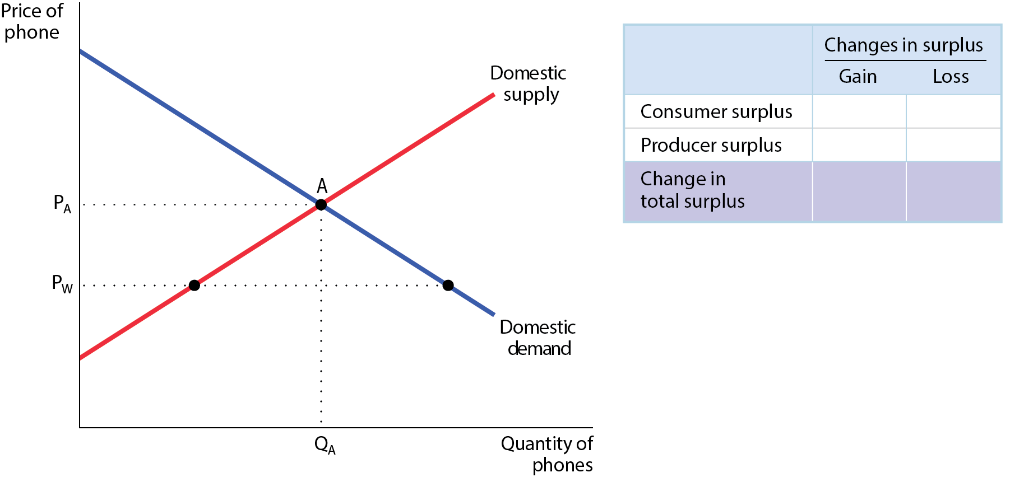
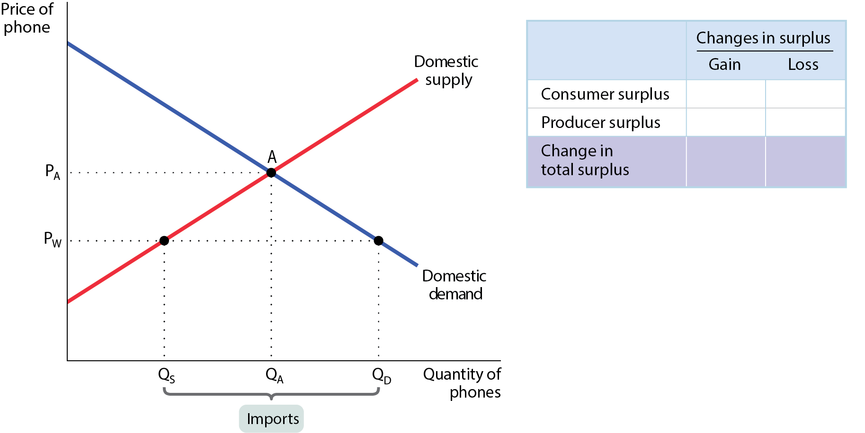
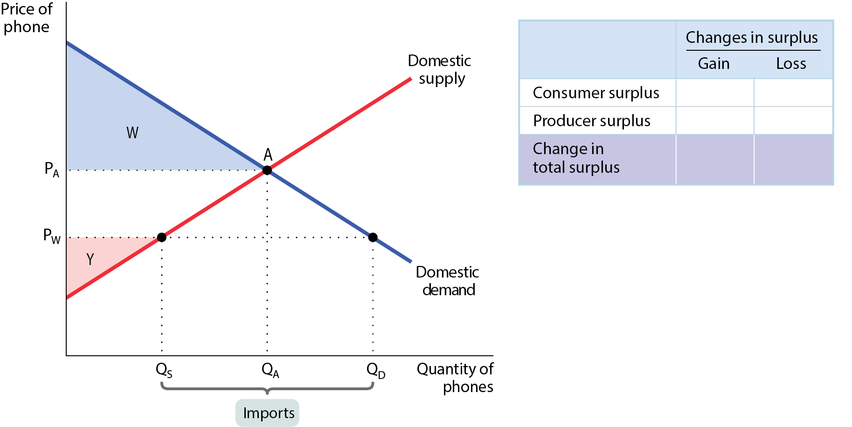
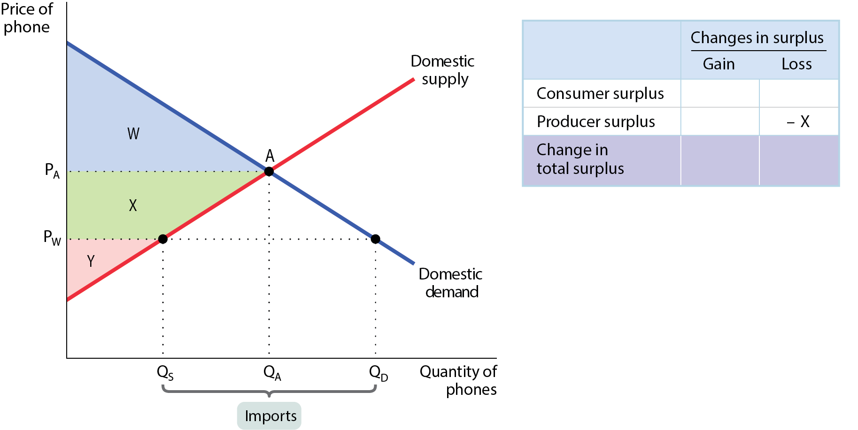
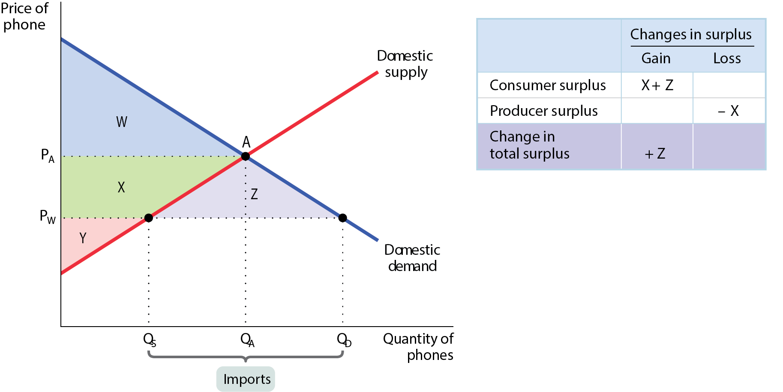
THE EFFECTS OF IMPORTS ON SURPLUS
Figure 16-3
When the domestic price falls to P_{W} as a result of international trade, consumers gain additional surplus (areas X + Z) and producers lose surplus (area X).
Because the gains to consumers outweigh the losses to producers, there is an increase in the total surplus in the economy as a whole (area Z).

Slide 26
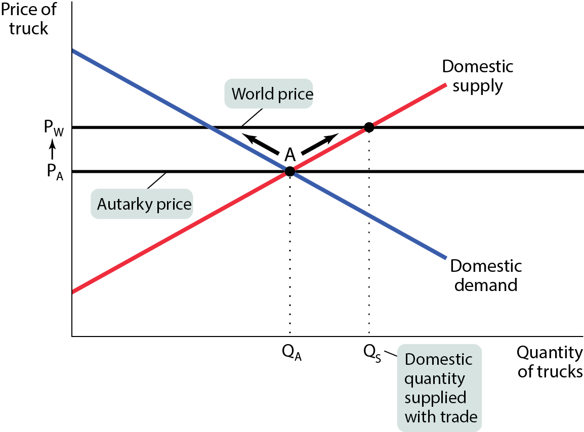
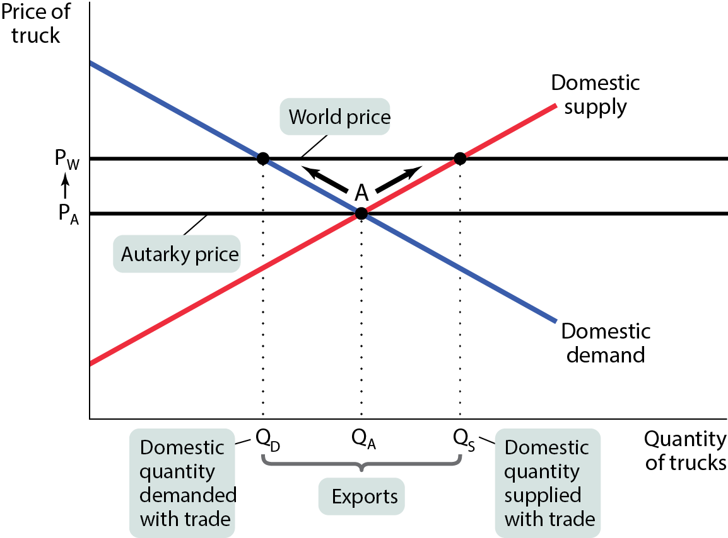
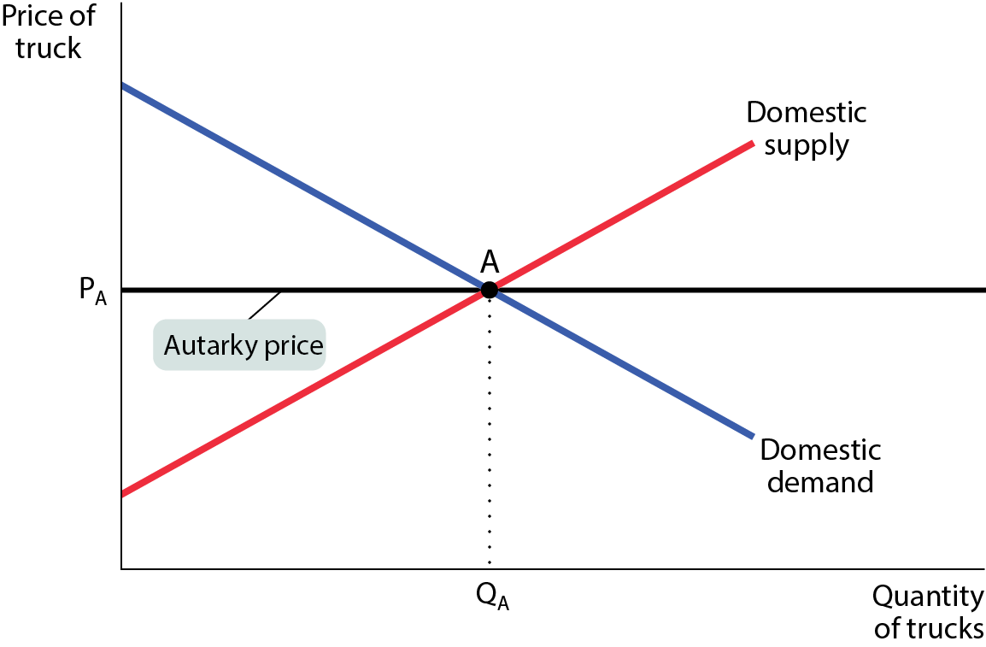
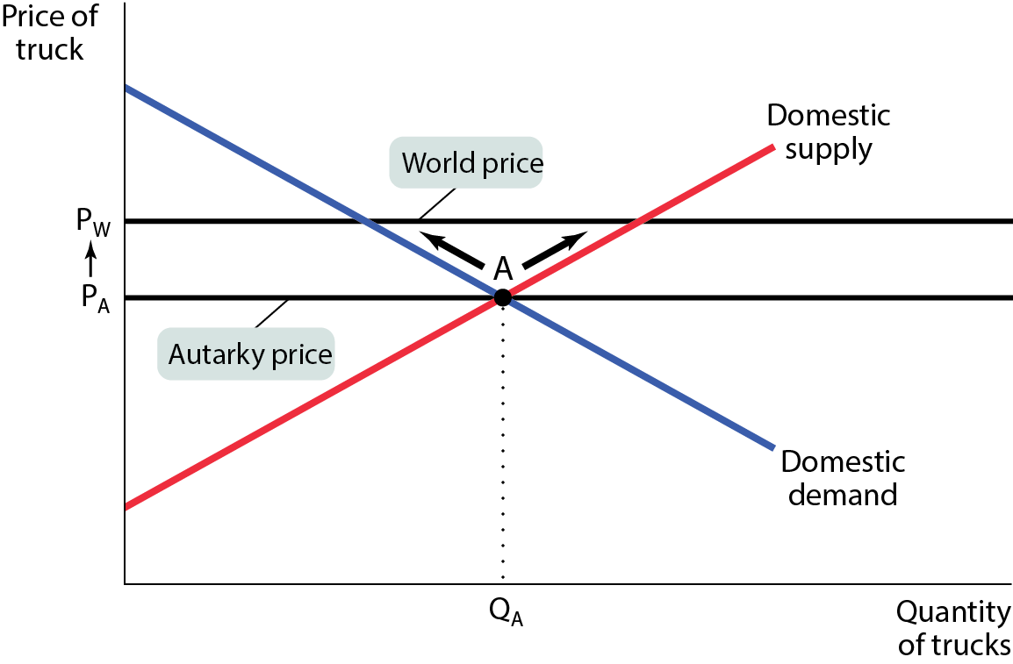
THE DOMESTIC MARKET WITH EXPORTS (1 of 2)
Figure 16-4

Slide 27
THE DOMESTIC MARKET WITH EXPORTS (2 of 2)
When the economy is opened to international trade, some of the domestic supply is now exported. The domestic price rises from the autarky price, P_{A,} to the world price, P_{W.} As the price rises, the domestic quantity demanded falls from Q_{A} to Q_{D} and the domestic quantity supplied rises from Q_{A} to Q_{S.}
The portion of domestic production that is not consumed domestically, Q_{S} − Q_{D}, is exported.

Slide 28
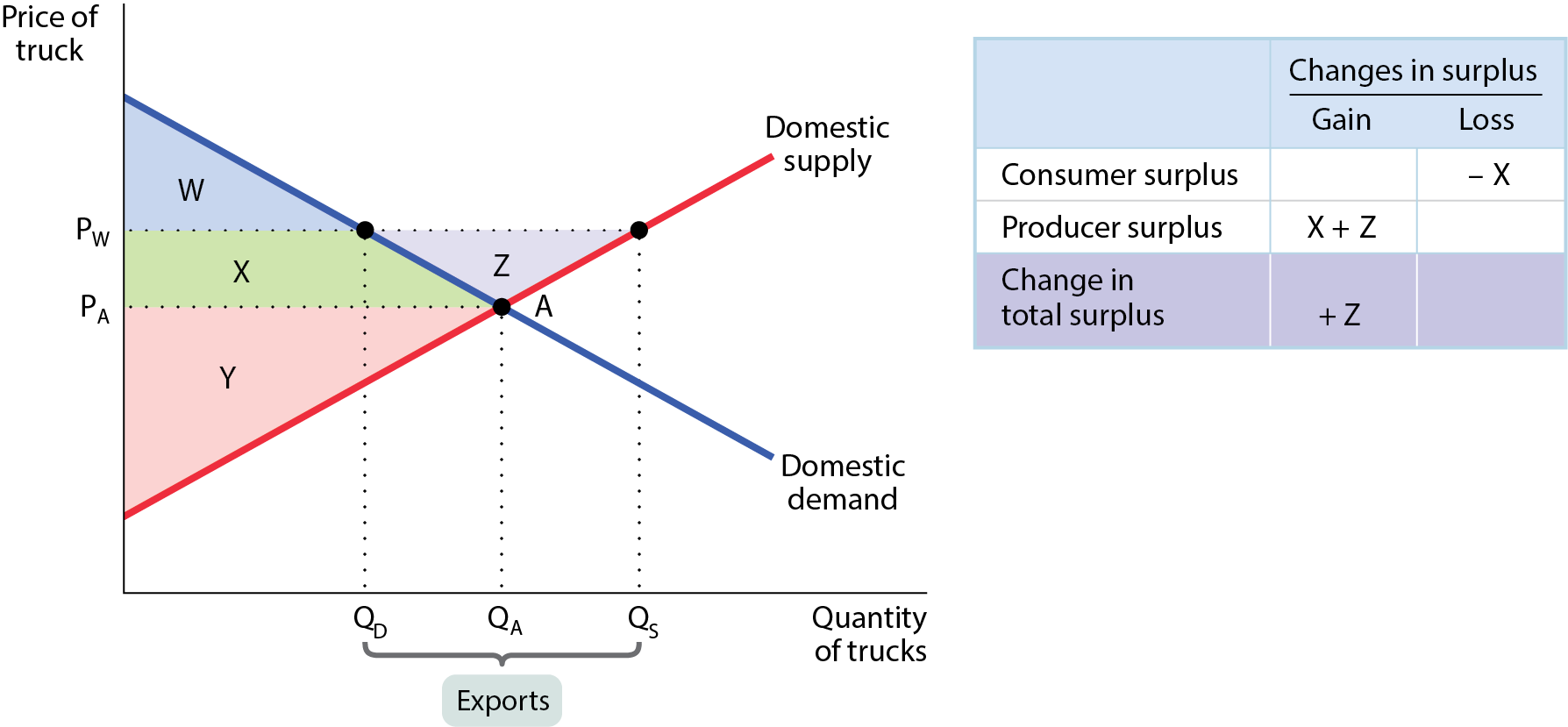
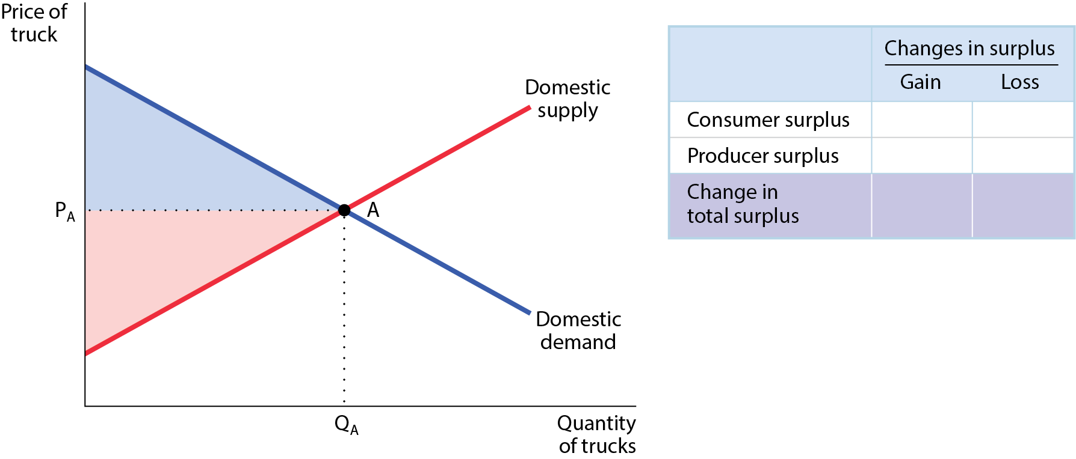
THE EFFECTS OF EXPORTS ON SURPLUS
Figure 16-5
When the domestic price rises to P_{W} as a result of trade, producers gain additional surplus (area X + Z) but consumers lose surplus (area X).
Because the gains to producers outweigh the losses to consumers, there is an increase in the total surplus in the economy as a whole (area Z).

Slide 29
LEARN BY DOING: PRACTICE QUESTION 1
Imports are bad for a country because they harm both domestic consumers and domestic producers.
true
false

Slide 30
LEARN BY DOING: PRACTICE QUESTION 1 - ANSWER
Imports are bad for a country because they harm both domestic consumers and domestic producers.
true
false (correct answer)

Slide 31
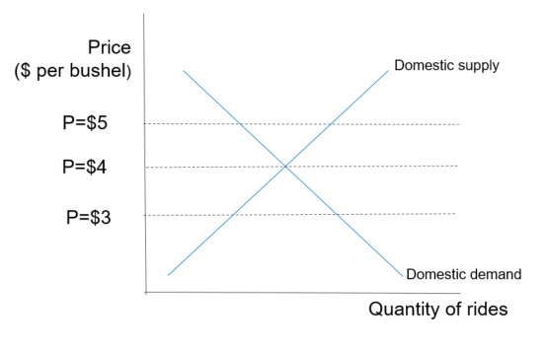
LEARN BY DOING: PRACTICE QUESTION 2
Suppose the accompanying graph represents the U.S. supply and demand for corn. If the world price of corn is $5.00 per bushel, the United States will
be an autarky
export corn
import corn
impose tariffs on corn
Notes:
A graph with depicting the Demand and Supply Curves of Price per bushel on the vertical axis and the Quantity of rides on the horizontal axis. The vertical axis has P=$3, P=$4, P=$5.

Slide 32
LEARN BY DOING: PRACTICE QUESTION 2 - ANSWER
Suppose the accompanying graph represents the U.S. supply and demand for corn. If the world price of corn is $5.00 per bushel, the United States will
be an autarky
export corn (correct answer)
import corn
impose tariffs on corn

Slide 33
INTERNATIONAL TRADE AND WAGES
Producers and consumers are not the only ones affected by trade.
Trade also affects owners of factors of production (labor, land, and capital).
The Heckscher–Ohlin model: A country tends to export goods that are intensive in factors that are abundant in that country and to import goods that are intensive in factors that are scarce.
Trade increases the demand for factors that are abundant and decreases the demand for factors that are scarce in a country. Prices of abundant factors tend to rise, and prices of scarce factors tend to fall.
U.S. exports are human-capital-intensive (high-tech designs, for example), while U.S. imports are unskilled-labor-intensive (clothing, for example).
Trade raises wages of highly educated American workers and reduces wages of unskilled workers. Trade increases wage inequality.

Slide 34
THE EFFECTS OF TRADE PROTECTION
Ever since David Ricardo explained comparative advantage, economists have advocated free trade, in which the government policy should not attempt either to reduce or to increase the levels of exports and imports that occur naturally as a result of supply and demand.
Policies that limit imports are known as trade protection or simply as protection.
Let’s look at the two most common protectionist policies, tariffs and import quotas.

Slide 35
THE EFFECT OF A TARIFF (1 of 2)
A tariff is a tax levied on imports.
A tariff has two effects:
Increase in domestic production, reduction in domestic consumption.
The good is now produced by the higher-cost country.
Less is consumed, leading to lower gains from trade.
Can we measure the value of wasted resources? Yes!

Slide 36
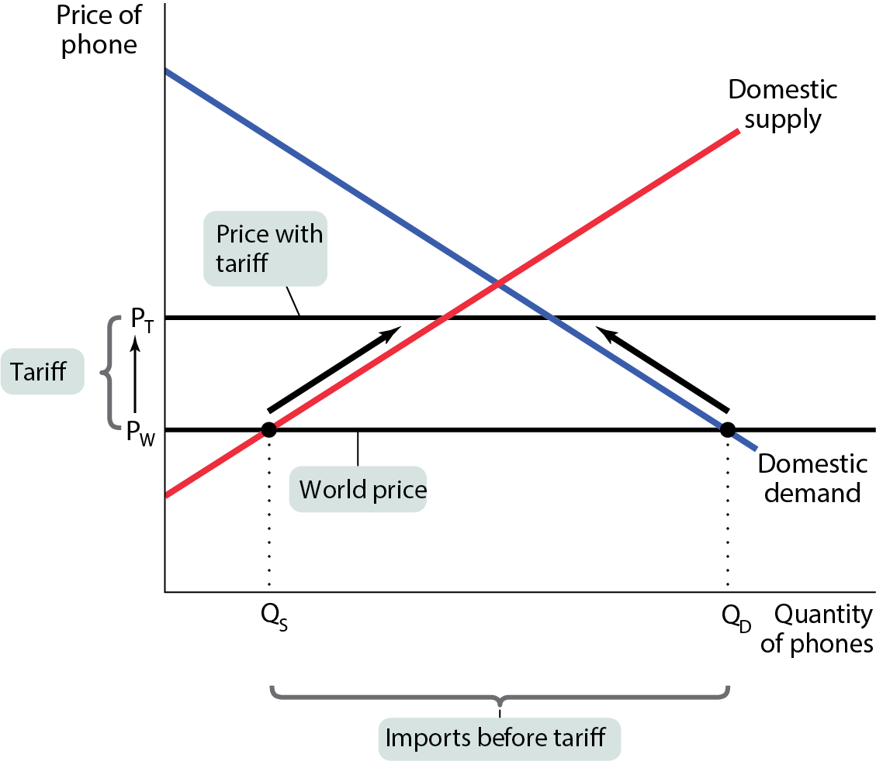
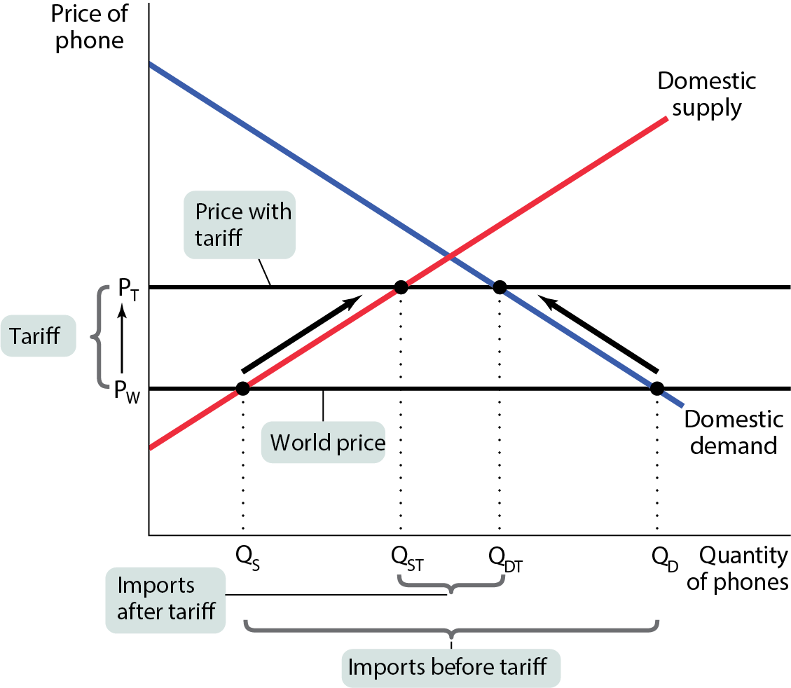
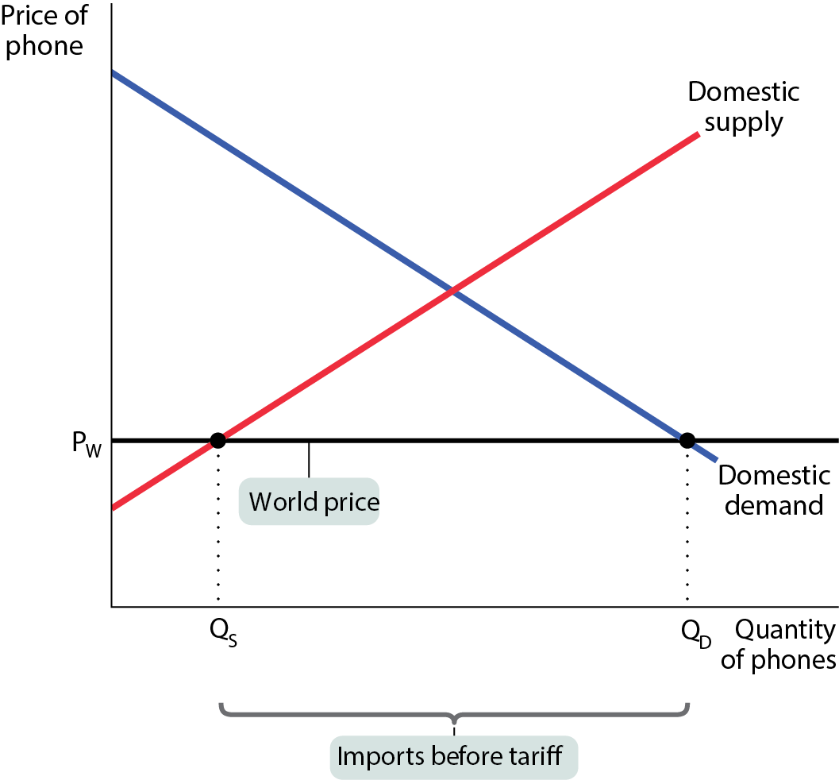
THE EFFECT OF A TARIFF (2 of 2)
The tariff pushes up the price, which reduces quantity demanded and increases domestic quantity supplied.
Figure 16-6

Slide 37
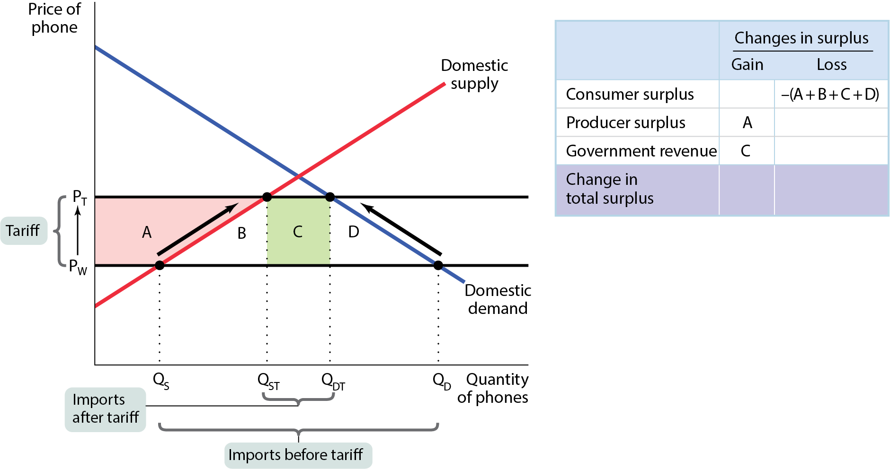
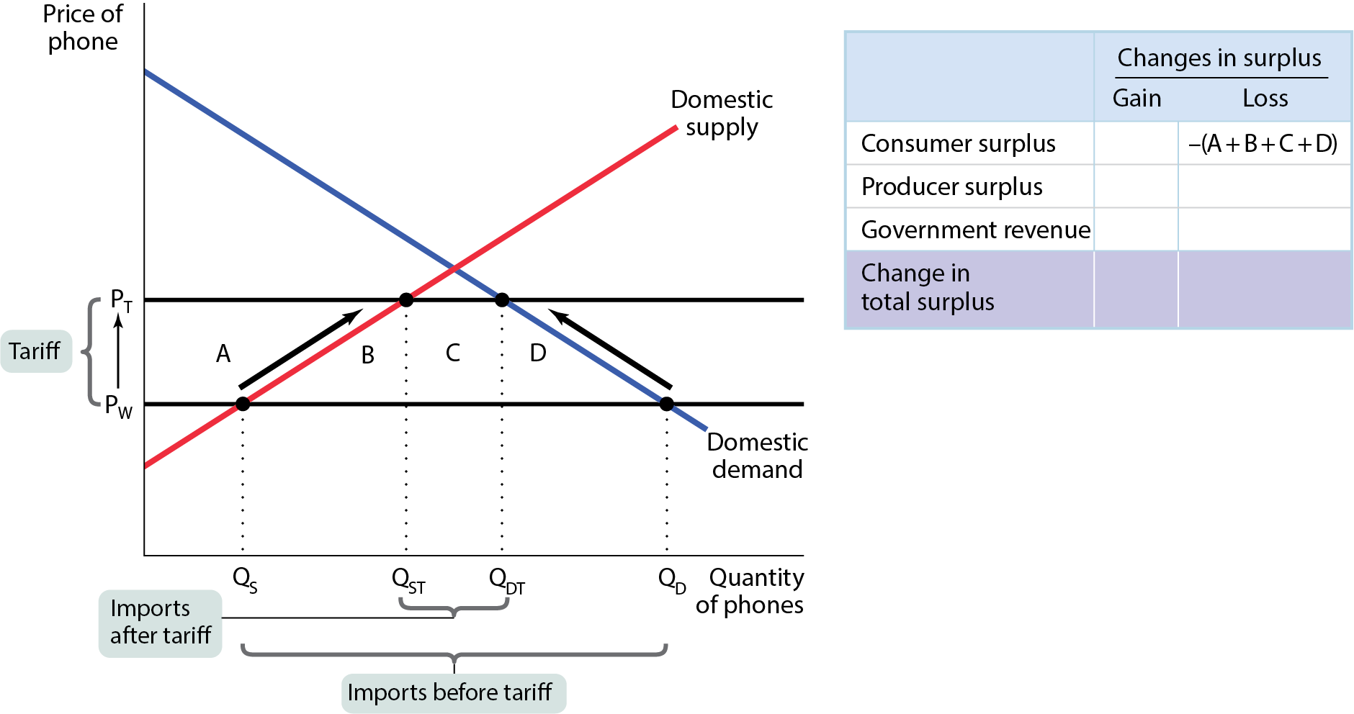
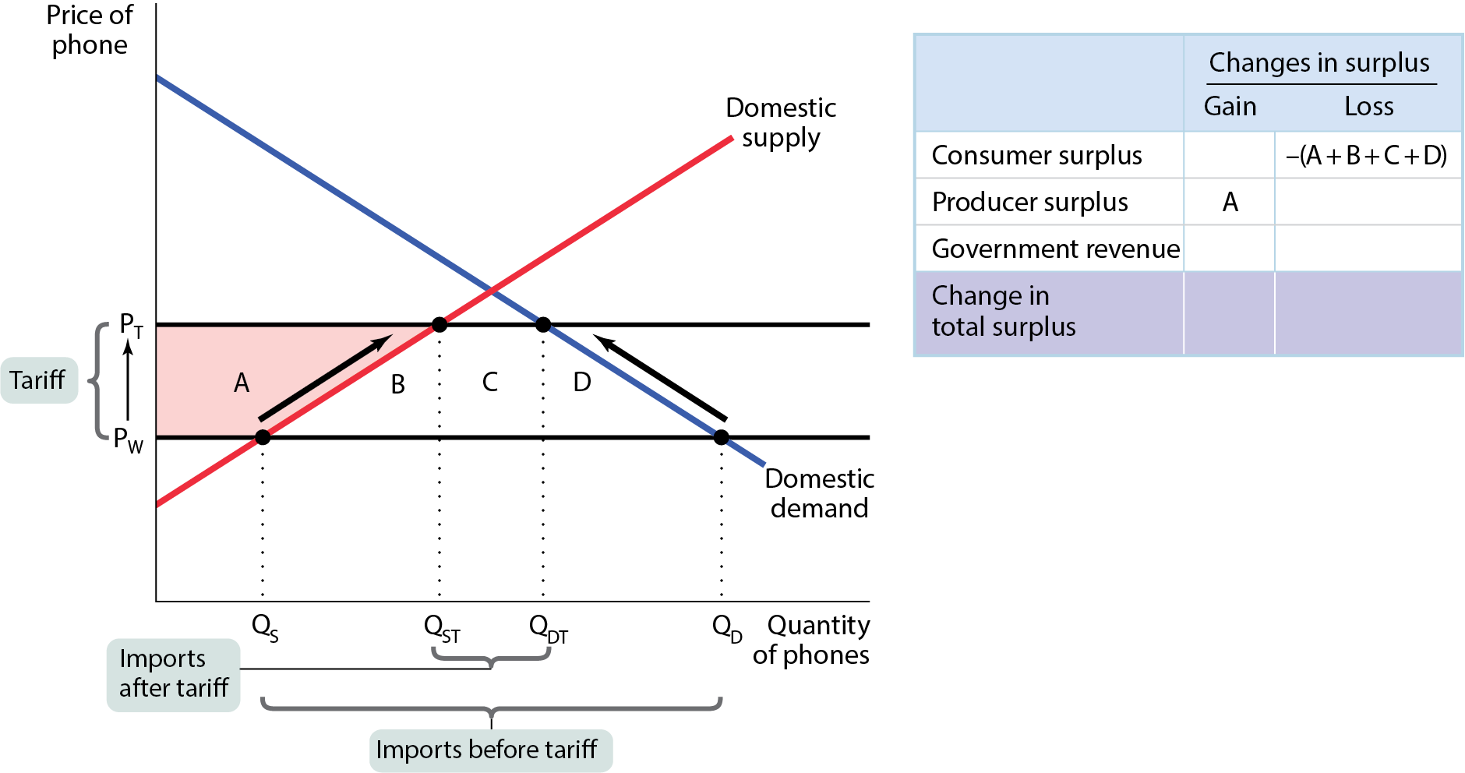
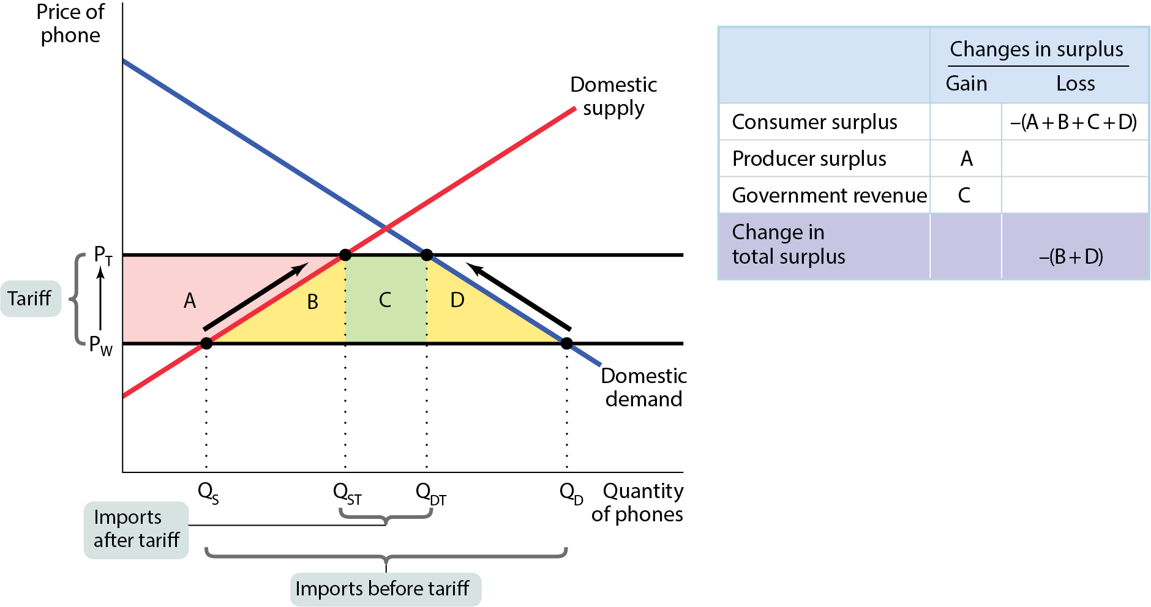
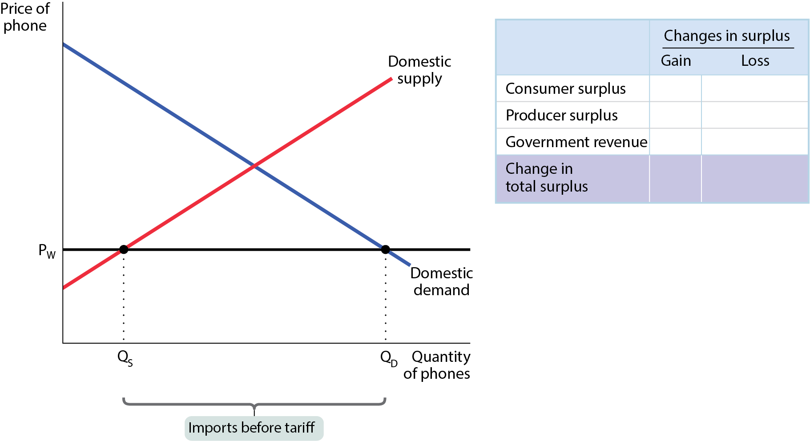
A TARIFF REDUCES TOTAL SURPLUS
The tariff reduces consumer surplus, increases producer surplus, creates new government revenue, and creates deadweight loss (areas B and D). Area D shows that some mutually beneficial trades go unexploited. Area B shows that tariffs cause some of the economy’s resources to be wasted on inefficient production.
Figure 16-7

Slide 38
THE EFFECTS OF AN IMPORT QUOTA
An import quota is a legal limit on the quantity of a good that can be imported.
The effect is the same as a tariff, except instead of government revenue, “quota rents” go to quota license holders (usually foreigners).

Slide 39
ARGUMENTS FOR TRADE PROTECTION
National security argument: A country should protect domestic suppliers of crucial goods to be self-sufficient. Protection is required even during peacetime to ensure their availability.
Job creation argument: Protection creates additional jobs. Economists argue that these jobs are often offset by the jobs lost elsewhere.
The infant industry argument: New industries need a temporary period of protection to develop. Critiques: It’s most often industries that are politically influential that gain protection; governments are poor predictors of best emerging technologies.

Slide 40
INTERNATIONAL TRADE AGREEMENTS AND THE WORLD TRADE ORGANIZATION (1 of 2)
Countries care about one another’s trade policies.
International trade agreements are treaties in which a country promises to reduce import tariffs in return for a promise by the other country to do the same
NAFTA (North American Free Trade Agreement): a trade agreement between the United States, Canada, and Mexico (currently being replaced by the USMCA)
EU (European Union): a customs union among 28 European nations

Slide 41
INTERNATIONAL TRADE AGREEMENTS AND THE WORLD TRADE ORGANIZATION (2 of 2)
Global trade agreements
The WTO (World Trade Organization) oversees international trade agreements and rules on disputes between countries over those agreements.

Slide 42

NEW CHALLENGES TO GLOBALIZATION
The decline of manufacturing. When wealthy countries like the United States export skill-intensive products (like aircraft) while importing labor-intensive products (like clothing), they can expect to see the wage gap between more educated and less educated domestic workers widen.
Offshore outsourcing: hiring people in another country to perform various tasks
Offshore outsourcing is still relatively small compared with more traditional trade.

Slide 43
LEARN BY DOING: PRACTICE QUESTION 3
A tariff results in a higher:
consumer surplus.
producer surplus.
government revenue.
I and II only
II and III only
I and III only
I, II, and III

Slide 44
LEARN BY DOING: PRACTICE QUESTION 3 ANSWER
A tariff results in a higher:
consumer surplus.
producer surplus.
government revenue.
I and II only
II and III only (correct answer)
I and III only
I, II, and III

Slide 45
LEARN BY DOING: DISCUSSION QUESTION 1
Which argument against trade is the strongest in your opinion?
Trade reduces the number of jobs in the United States and should therefore be limited.
It’s wrong to trade with countries that use child labor.
We need to keep some industries for reasons of national security.
We need to protect certain industries while they develop.

